Slide 1
PySpark
Outcomes:
Introduction to Hadoop Architecture
PySpark for Data Frames

Slide 2
Advantages of Spark DataFrame
Scales from desktop to PetaFLOPs
Seamless integration with various Big Data tools and Storage Systems
APIs for Python, Scala, Java, and R

Slide 3
DataFrames are …
Preferred abstraction of data in Spark
Distributed (by design) across the Hadoop cluster
Built on Resilient Distributed Datasets (RDD). At least three copies across the cluster
Immutable once constructed
Benefits:
Compute in parallel
How to Build a DF?
Convert Pandas DF
Transform an existing DF
From files in HDFS or any other storage system such as Parquet

Slide 4
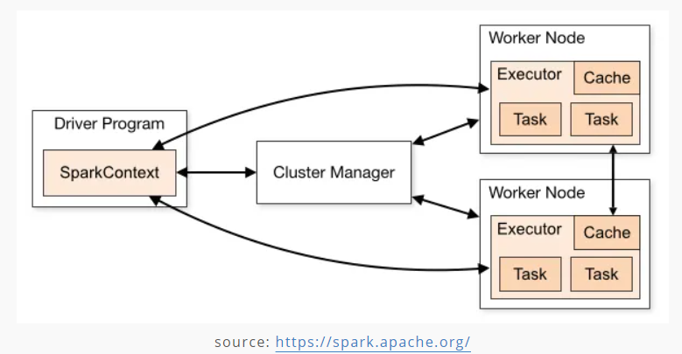
PySpark
Features
Big Data in Realtime
In-memory computing
Spark Context (SC)
Linux
Speed Caching
PolyGlot (supports several languages)
Widely used across verticals
Resilient Distributed Datasets (RDD)
sc.Parallelize()

Slide 5
PySpark: Parallelize() Distribute the data across multiple nodes
Parallelize() is a function in SparkContext
Creates Resilient Distributed Datasets (RDD) from a list collection.
RDD is a data structure.
Each dataset in RDD is divided into logical partitions, each partition may be computed on a different node of the cluster.
nums = list(range(0,100000,1)
sc = sparkContext.parallelize(nums)
Creates an RDD and distributes “nums” across workers in Hadoop environment
Let’s see how this works!

Slide 6
Resilient Distributed Data: Parallelize()
Creating RDD
1
1
Python List
1
Partition-1
10
10
11
11
Partition-2
100
101
100
102
101
Partition-3
103
102
103

Slide 7
DataFrames vs. RDD vs. Dataset
DataFrames
API support for programming languages such as Scala, Java, and R
Easy to program compared to using RDD
Code optimization provides improved performance of the DataFrame
Resilient Distributed Data
Immutable once created
Divided into logical partitions across nodes on a cluster
Provides OOP style with compile-time safety (e.g., if you access a column that doesn’t exist in the table: RDD detects sooner. DataFrame APIs detects the attribute error at runtime only!)
Datasets
Allows conversion of existing RDD and DataFrame into Datasets
Provides OOP style with compile-time safety (e.g., DataFrame APIs do not support compile-time error. It detects attribute error at runtime only!)

Slide 8
Overhead: Garbage Collection
RDD. Immutable.
Each time an object (row/column element) is modified
Create/destroy individual objects
DataFrame
No garbage collection
Avoids cost of creating/destroying individual objects for each row in the dataset
Dataset
No garbage collection

Slide 9
PySpark With Jupyter Notebook
#Create an environment (if you like to keep this install separate)
conda activate fall23-5300
pip install pyspark
Luanch Jupyter notebook
#change kernel to fall23-5300
import pyspark
from pyspark.sql import SparkSession
spark = SparkSession.builder.appName(‘Org’).getOrCreate()
sc = spark.sparkContext
import numpy as np
Testing
numbers = list(np.arange(0,100000,1)
#create an RDD and distribute the list across available nodes
numbers_rdd = sc.parallelize(numbers)
#list the numbers using methods
numbers_rdd.collect()

Slide 10
Narrow Transformation: Spark Job Optimization
One-to-One Transformation
Transformations and Actions:
Each transformation produces a new RDD because RDD is immutable
Lazy transformation.
Executes when called but, not immediately!
DataFrames Vs Datasets
RDD
New RDD
RDD
/New RDD
RDD
New RDD
RDD
New RDD

Slide 11
Wide Transformation: Spark Job Optimization
Parallel transformations
Partitioning: All jobs are not created equally!
Repartitioning
Serialization: Data (into RDD), and closure (introduced into computation)
Memory Management: application driver executor memory (for data movement, swap, etc.)
Cluster resources (load, hardware, accelerators, etc.)
One to Many
RDD
New RDD
RDD
New RDD
RDD
New RDD

Slide 12
Installing Spark on Oracle VM
STOP! You need Oracle VM or another Working Linux Environment!
Install java
$sudo apt update
$sudo apt install openjdk-11-jdk
$sudo apt install openjdk-11-jre
$export JAVA_HOME=/usr/lib/jvm/java-11-openjdk-amd64
$export JAVA_JRE==/usr/lib/jvm/java-11-openjdk-amd64/jre
Install python
$sudo apt install python3-pip
Install Jupyter
$pip3 install jupyter
Install scala
$sudo apt-get install scala
Install py4j
$pip3 install py4j

Slide 13
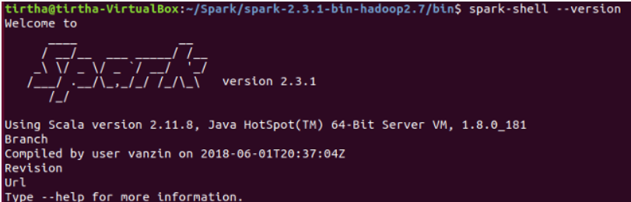
Installing Spark on Ubuntu VM
Download spark package
$wget https://dlcdn.apache.org/spark/spark-3.3.2/spark-3.3.2-bin-hadoop3.tgz
$sudo tar -xzvf spark-3.3.2-bin-hadoop3.tgz
$ln -s spark-3.3.2-bin-hadoop3 spark
Add following lines at the end of the file “.bashrc”
$nano fun~/.bashrc
export SPARK_HOME=/home/username/spark export PYTHONPATH=$SPARK_HOME/python:$PYTHONPATH export PYSPARK_DRIVER_PYTHON="jupyter" export PYSPARK_DRIVER_PYTHON_OPTS="notebook"
Run .bashrc
$source ~/.bashrc
Test Spark Installation
$cd spark/bin
$./spark-shell --version

Slide 14
Install Spark on Mac M1
Install HomeBrew package manager
$/bin/bash -c "$(curl -fsSL https://raw.githubusercontent.com/Homebrew/install/HEAD/install.sh)“
#Add Java into PATH
$(echo; echo `eval “$(/opt/homebrew/bin/brew shellenv)” `) >> /Users/username/.zprofile
$eval “$(/opt/homebrew/bin/brew shellenv)”
#install OpenJDK
$brew install openjdk@11
#install scala
$brew install scala
#install python
$brew install python
#install spark
$brew install apache-spark
#Run PySpark
$pyspark
#Test the installation
#create a DF in pyspark shell
>>>data = [(“Java”, “2000”), (“Scala”, “10000”)]
>>>df = spark.createDataFrame(data)
>>>df.show()
_1 _2
Java Scala
2000 10000
How to Install PySpark on Mac (in 2022) - Spark By {Examples} (sparkbyexamples.com)

Slide 15
Tutorials
PySpark Tutorial For Beginners | Python Examples — Spark by {Examples} (sparkbyexamples.com)
Tutorials on using PySpark with Jupyter Notebook.
PySpark Dataframe Tutorial | Introduction to Dataframes | Edureka
Google Cloud Project (look for instructions)
How to set up PySpark in Jupyter notebook | Opensource.com
PySpark parallelize() - Create RDD from a list data — SparkByExamples
DataFrame

Slide 16
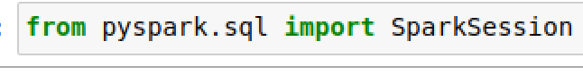
Testing the Installation in Jupyter Notebook
Run within Jupyter Notebook
$cd $HOME
$mkdir pyspark-tests
$cd pyspark-tests
$Jupyter notebook
Test in Jupyter Notebook. If the command completes with no errors, the installation is successful.

